Slide 1
Settling Payments Fast and Private: Efficient
Decentralized Routing for Path-Based Transactions
Stefanie Roos, Pedro Moreno-Sanchez, Aniket Kate, Ian Goldberg
Persenters: Li Xue and Ke Wang
Challenger: Shresta

Slide 2
Outlines
Background
Limitations
PBT Network
Related Work
Routing Algorithm: SpeedyMurmurs
Evaluation
Conclusion

Slide 3
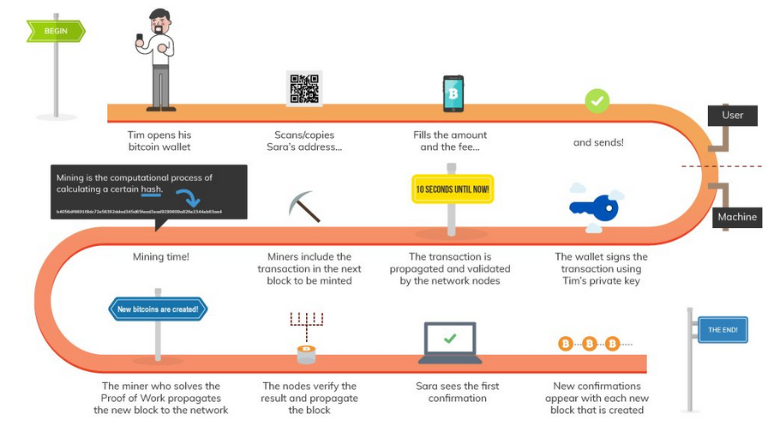
How Does Blockchain Work
Notes:
Proposed on 2008,
very single transaction is being stored in a massive distributed public ledger called the Blockchain.
Book-keeping through distributed ledger is an essential function of the blockchain. There are many application for blockchain, the major benefit of using it lay in its…

Slide 4
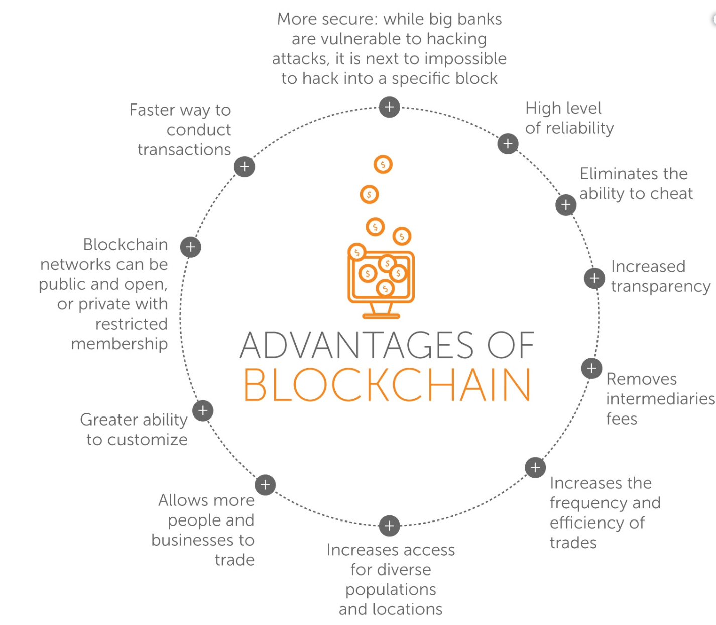
Blockchain Can Do Many Things
More than 120 ongoing use cases (Data from 2016):
Captial market
Healthcare
Energy
Investment
etc
Source: https://www.experfy.com/blog/blockchain-use-cases-that-have-potential-to-disrupt-society
Notes:
marketing
renewable energy
dApps
trading
business
government transparency
There are more than 120 ongoing blockchain use cases, ranging from .capital market, healthcare to energy and investments.

Slide 5
Blockchain
The blockchain’s core value
Enabling its participants to provably and permanently agree on exactly what data was entered, when and by whom, without relying on a trusted intermediary.
Public-Blockchain maintained
Costly
The transaction speed based on the fee you pay (~7 dollars/Per Transaction)
Slow

Slide 6
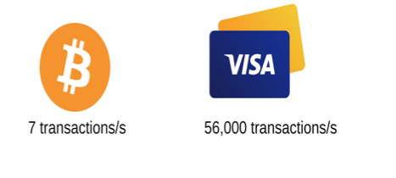
Limitation of Blockchain
Scalability
Privacy
Notes:
Use the Bitcoin as an example, other protocols has the same problem
Bitcoin was proposed in 2008,the very first comment on the system was: scalability ; Ten years later, scalability is still the biggest problem .. Well, ..While this was enough at the very beginning, the system has been congested for a few years now. As a result, transactions take a long time to process and transaction fees are extortionate.
In order to understand the situation, see from the numbers. If global transaction and every one use, it is too slow. You need download whole blockchain not willing to invest much storages
Moreover, the public nature of Blockchain lead to the privacy braches to sensitive data

Slide 7
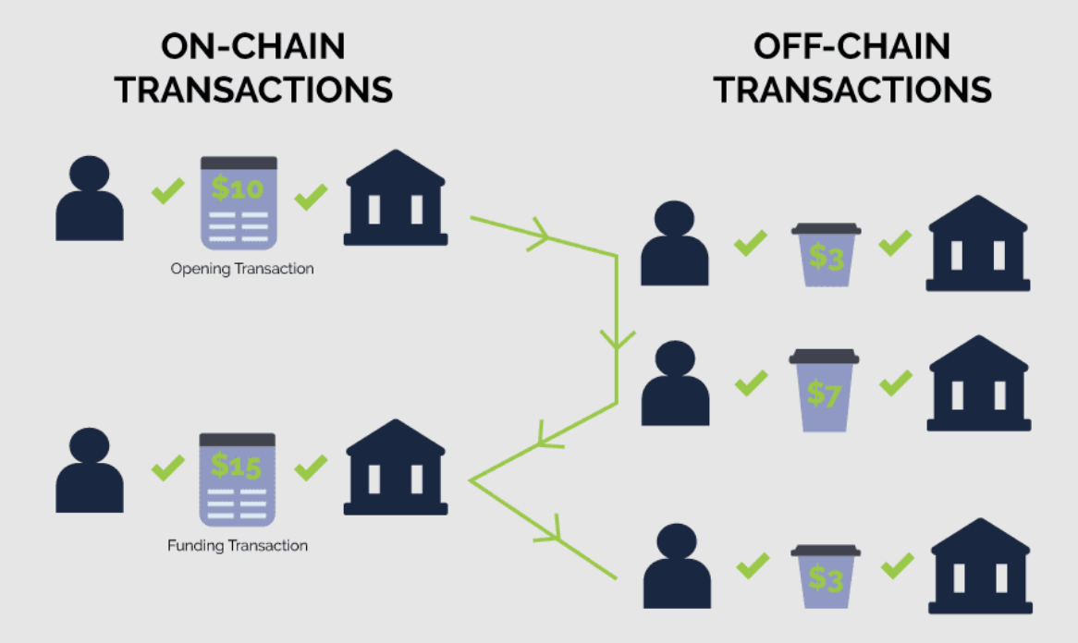
Solution: Off-Chain
Add another layer to blockchain
Enable users to create payment channels between any two parties on that extra layer
Examples: Danny and John need to send money very often, quickly and with minimal fees
Setup Channel
Shared wallet:
They need to create a multisignature shared wallet
3) Deposit
They both deposit a certain amount of Bitcoins
Transaction
Unlimited transactions can happen between them, which means redistribute the funds stored in the wallet.
Channel closed
Final Balance is Broadcasted to the blockchain
we really don’t need to keep a record of every single transaction on the blockchain. they are OFF-CHAIN
Notes:
o, the way the Lightning Network works is it enables users to conduct numerous transactions outside of the main blockchain and then record them as a single one
Reduce the load of blockchain

Slide 8
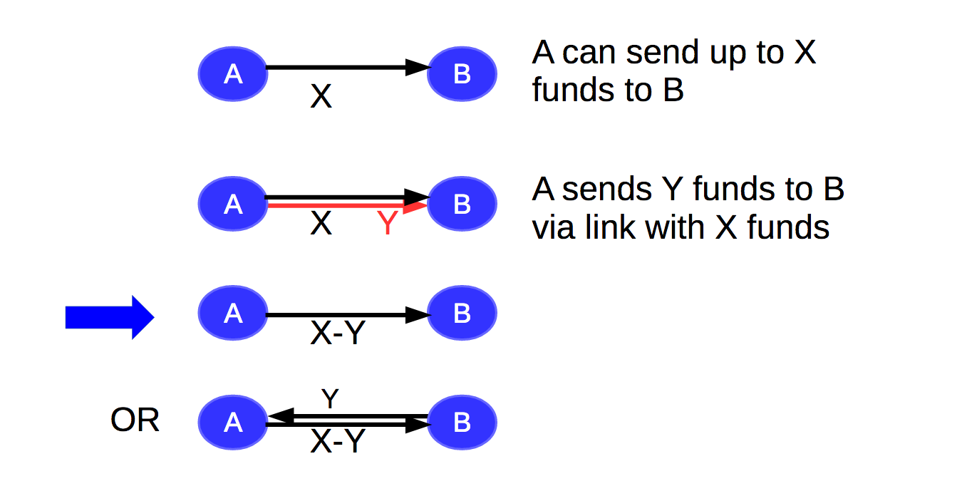
Off-Chain Transactions
Take Lightning network as example
Notes:
Let’s say, A participant A B, open link or payment channel
X can be any currency you want
Depend on your setup, one direction or bidirectional.
Only the way distributed are changes.

Slide 9
Decentralized Path-Based Transaction
In a PBT network, pairs of users locally maintain weighted links (i.e.local payment channel)
Pairs of participants leverage these channels to settle payments via a path of intermediaries without the need to record all the transactions in a global blockchain
The weight of the link, is dependent on the applications
The link weight characterizes the amount of funds (or assets) that one user can transfer to the other
In credit network, the weight means the amount of money owe one to another
Applications:
Lightning network for Bitcoin
Raiden network for Ethereum
SilentWhispers for credit network …
Notes:
Another important word: pbt

Slide 10
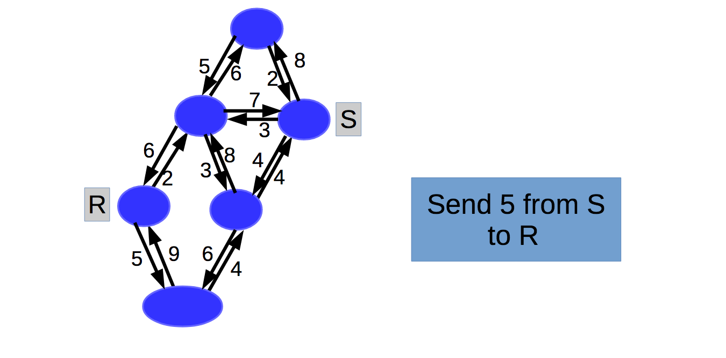
Path-Based Transactions (PBT) Example
Notes:
Imaging you have a whole network consisting of these payment channels.
Whole uses have decided we have this type of channels and use them.
You do not need to open the channel to everyone, only to the node you know

Slide 11
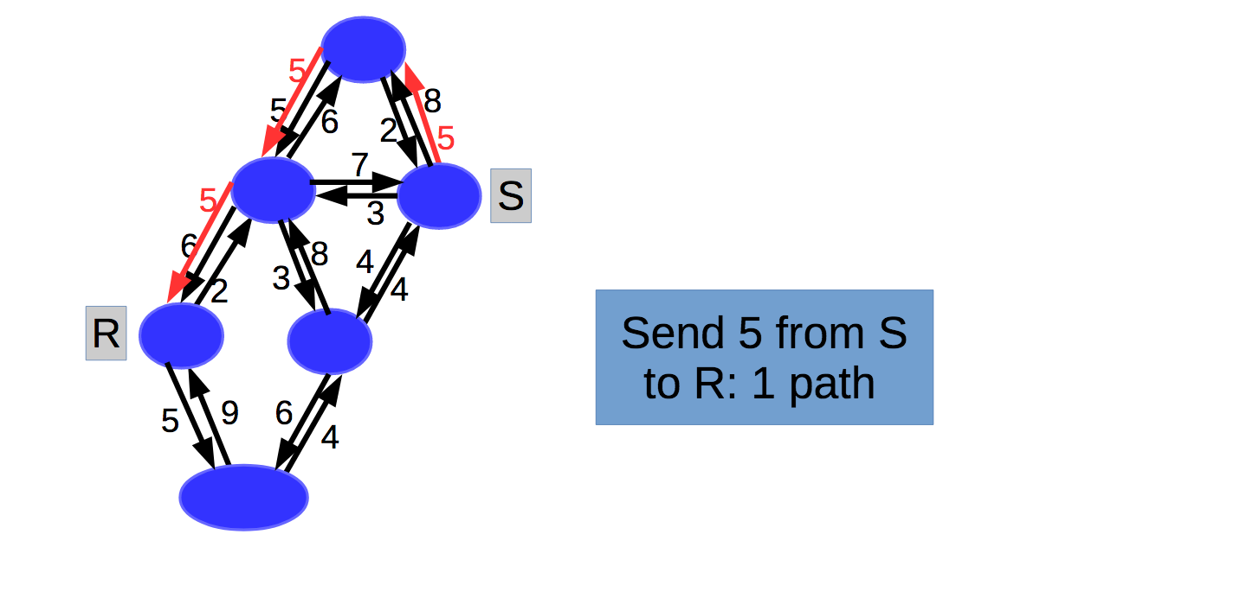
Path-Based Transactions (PBT) Example Continuing
Notes:
S, R; S R no payment channel.
The inmide node along the path will have the same total amount income and outcome, distributed in slight different way
The sender decrease by 5, and the receiver increase by 5
But, maybe want to send 6.one link of the path only have capacity of 5

Slide 12
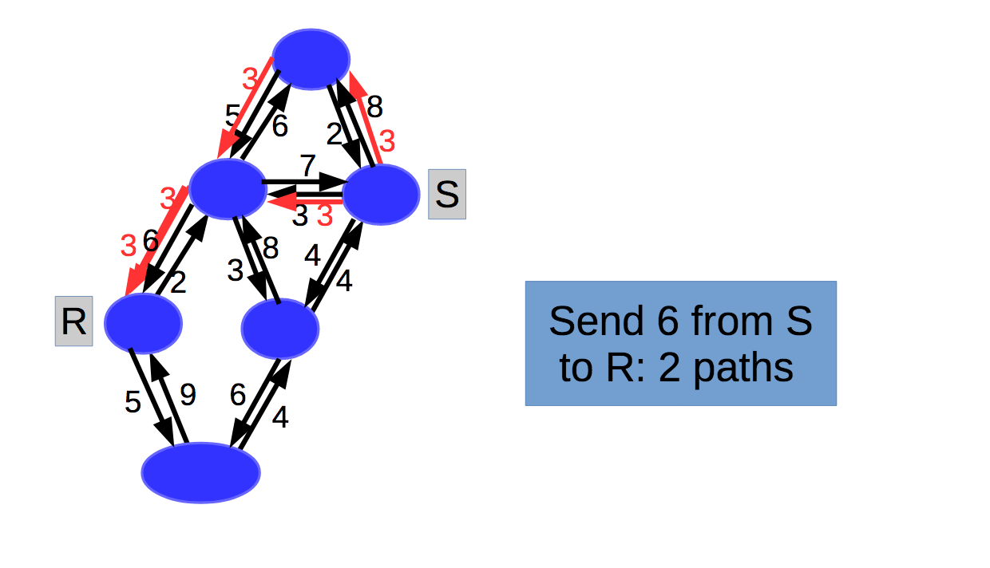
Path-Based Transactions (PBT) Example Continuing
Notes:
You can use multiple path.
Two problem:
How many path
How to select

Slide 13
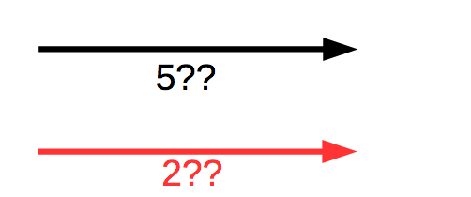
Path-Based Transactions (PBT): Algorithms
Routing
Payment
Accountability
Finds paths with enough funds from sender to receiver
Settles the funds between sender and receiver along the paths connecting them
Allows the resolution of disputes in the presence of misbehaving users
Notes:
PBT network builds on top of three key algorithms: Routing, payment and accountability.
Routing: finding path and assign the red values
To cheat not update correctly, correct and value. They are collected.
Signature, block chain. Lightning network. Verification. Signature
Solutions for payment and acountability
Solution for Routing focues, no solution doable at this moment

Slide 14
Paper Contribution on the Blockchain Ecosystem
Blockchain
Routing + Payment + Accountability
Offchain
Path-based Transaction
Routing Algorithm (Contribution)

Slide 15
Routing Algorithm is important
Effectiveness
Successfully resolved transactions / Total transactions
Efficiency
Delays during a transaction and Overhead created by the transaction
Scalability
The ability of a PBT network to maintain effectiveness and efficiency for a growing base of users and transactions
Privacy
Keep Sensitive data safe: Transaction value, The Identity of sender and receiver, the debt, etc.
Notes:
In academy and industry, These three characters are the main concern for designing routing algorithm of PBT network.
Effective/efficiency property of scalability
Become fast updated.

Slide 16
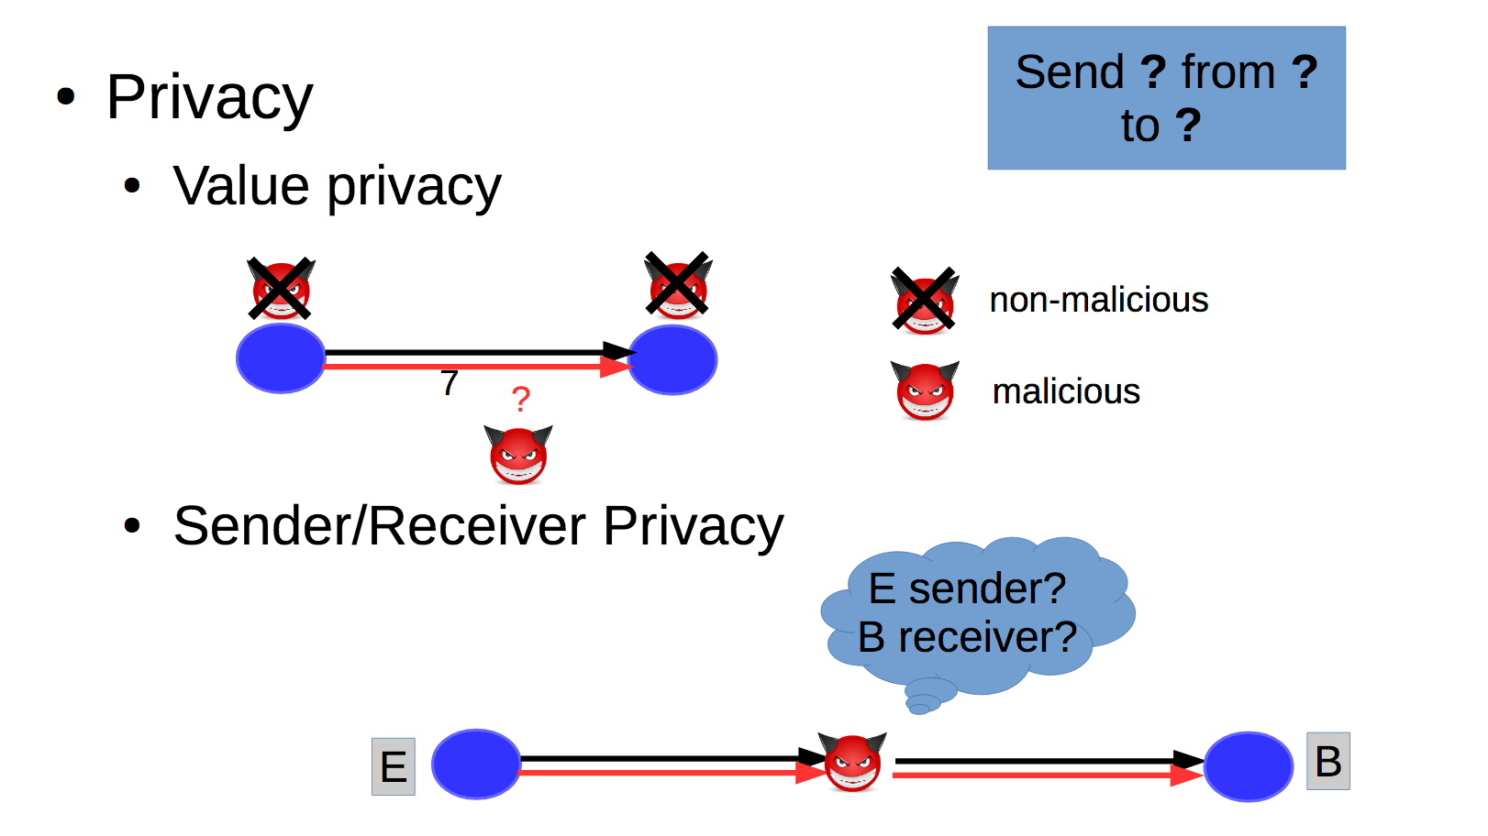
Privacy Goals
Notes:
At beginning, two issues need to be consider, one is scalability,
The other one is privacy.
Very high level, id and value. Later. Value is hidden, and adversary can not get the value from indimidiate node.
Leak: This is dir come, the other go to. Indimidate node can not tell if the node before is sender or in, the subsequcee node is des/i.

Slide 17
Related work
Ripple/Stellar
Relying on a public blockchain that logs the complete PBT network, thus it introduces blockchain fees and impeding privacy
Canal/Privpay
Central server, suffering single point failure
Flare
Leaking sensitive data due to every users in the path from sender to receiver to send the current fund amount for the payment channel
SilentWhispers
The most promising approach with regard to privacy, however it lacks efficiency
Notes:
Flare used in lightning network: P2P routing, keep track all the payments channel
Not so dynamicly.
Not the good solution.

Slide 18
Notes:
Flare used in lightning network: P2P routing, keep track all the payments channel
Not so dynamicly.
Not the good solution.

Slide 19
The types of PBT network
PBT network based on Landmark routing
SlientWhisper
PBT network based on Embedding-based routing
VOUTE

Slide 20
Landmark Routing
Notes:
Main idea: Calculate subset of all paths
Dedicated node often can be node with high degree, and high bandwith

Slide 21
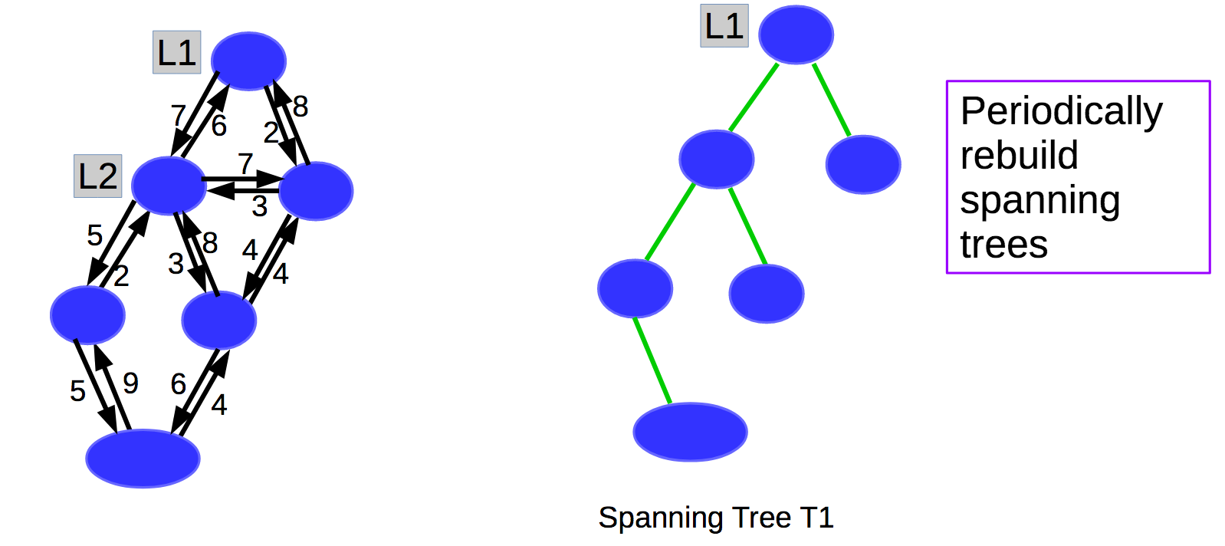
SlientWhispers: Setup
Notes:
Slientwhispers utilized land-mark-centered routing to discover multiple paths and then performs multi-party computations
Two landmarks: each of them you build an spanning tree. Just l1.
Network situation changes, and the Slientwhispers will periodically rebuild the spanning tree.To follows the dynamics

Slide 22
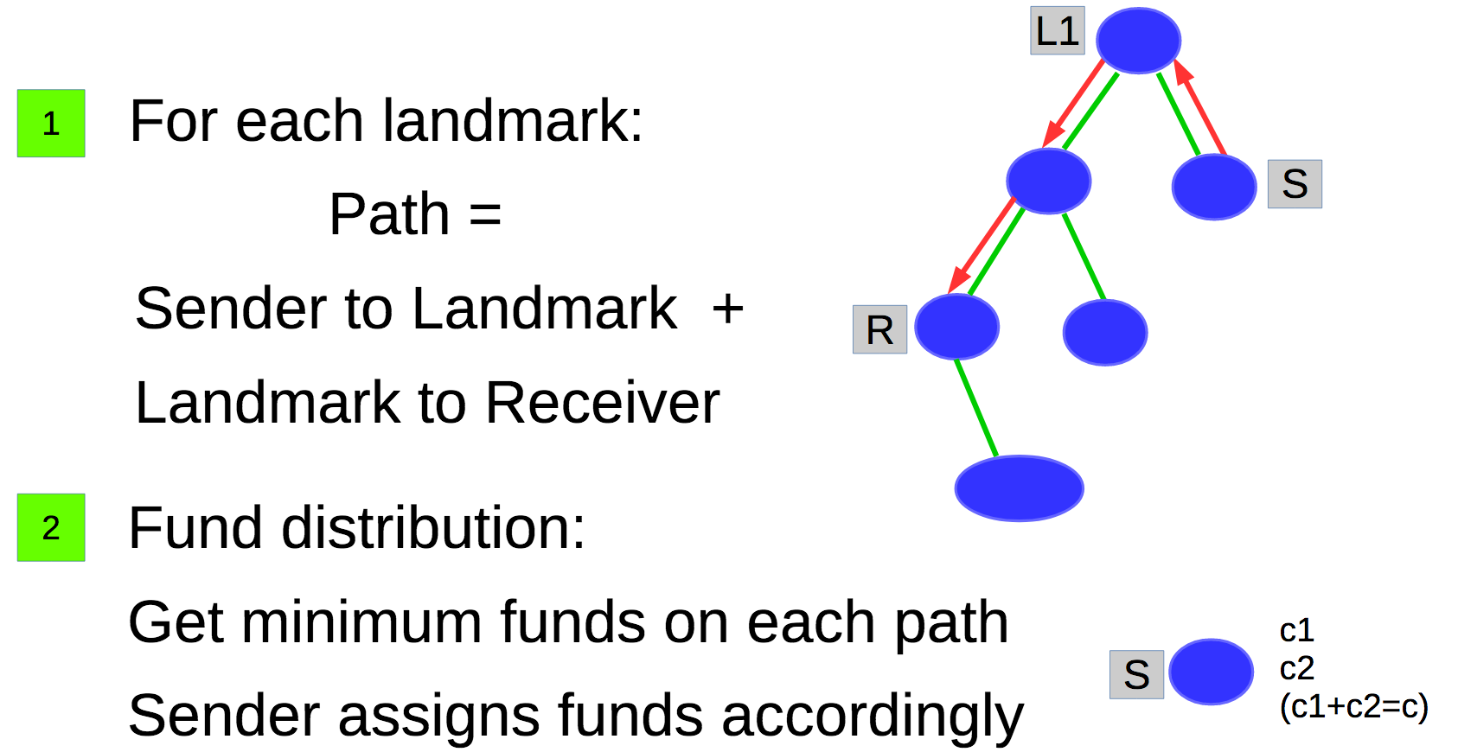
SlientWhispers: Routing
Notes:
How do we route in this network, scalable linearly in the depths of the spanning tree
Had landmark
Look at each lanmarkget a path the sender and lanmark to destination.
How to distribute the fund : the minmum is the max we can send

Slide 23
Limitations of SlientWhispers
Failure due to outdated information
Computation Overhead due to unnecessarily path computation
The overall path is unnecessarily longer than reality
Longer delayer and lower success ratio
Transaction overhead due to number of landmarks
No concurrency
Notes:
Transaction overhead due to number of landmarks
The probe operations requires that the nodes included in a transaction path send shares to all landmarks. This means that the transaction overhead scales quadratic ally in the number of landmarks.
No concurrency
Do not provide a suitable solution for concurrency

Slide 24
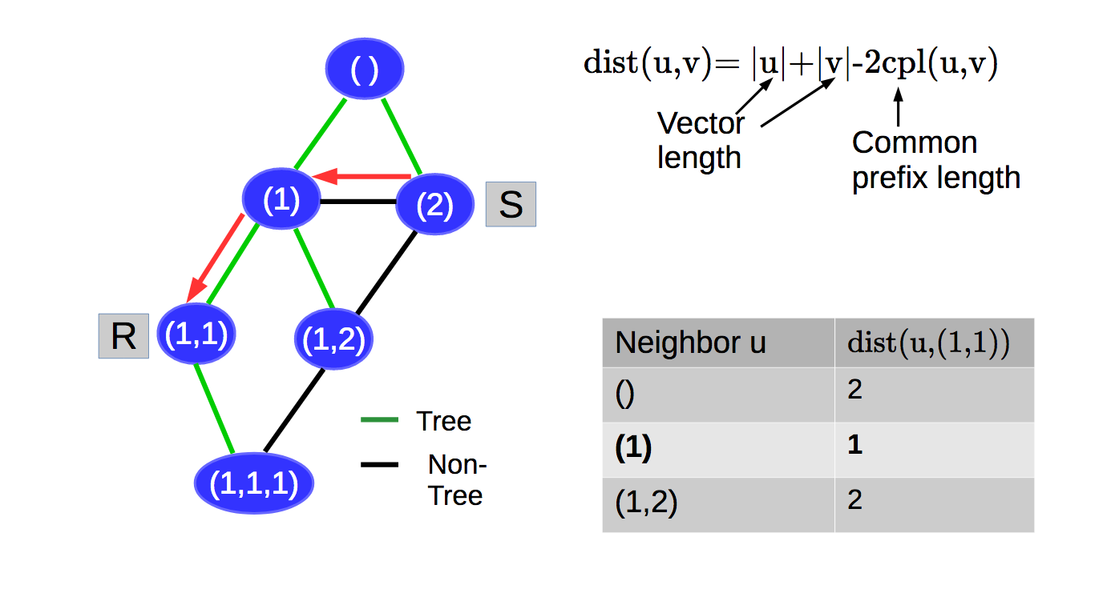
Embedding-based Routing
Notes:
A bit more flexible, using embbedding –based routing, which assigned coordinates based on the node position in the spanning tree.
that reflect the structure of the payment network
Then disregard the tree, to find the shorter path using links are not in the spanning tree. (Shortcut)
S will do during the routing is in network, look the neighbors.
|id] denote the coordinate length of node u.
Common prefix: the number of initial elements that they have in common

Slide 25
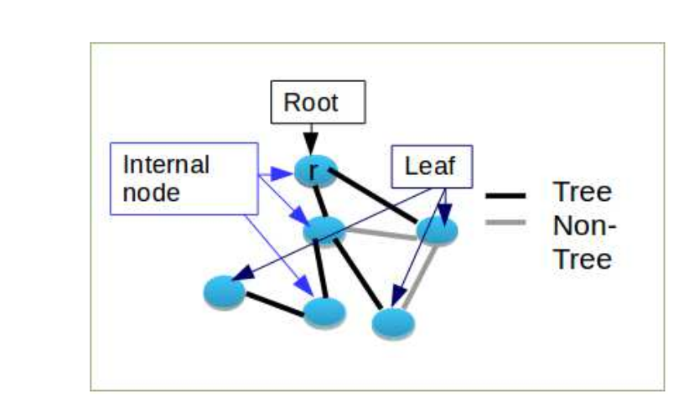
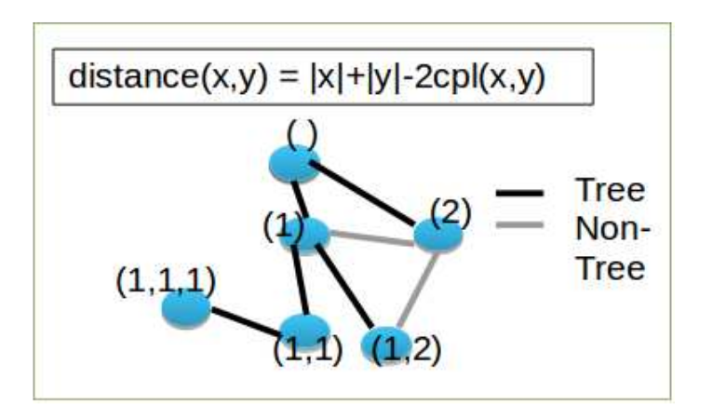
VOUTE
Rooted Spanning Tree
Prefix Embedding-based: VOUTE
Notes:
VOUTE IS A rouging algorithm building upon prefix embedding with the goal of anonymous and efficient message delivery

Slide 26
Advantage for VOUTE
VOUTE is a routing algorithm building upon prefix embedding with the goal of anonymous and efficient message delivery for a dynamic route-restricted network
Address privacy
Provide anonymous return address instead of their original coordinates
Receiver generates a return address by padding its coordinates to a fixed length and generating keyed hashes of the coordinates elements
Address+key hashes + key
Address dynamic
On-demand stabilization by repair the tree based on the newest invitation

Slide 27
Limitations of VOUTE
VOUTE ONLY considers undirected and unweighted links
PBT network instead is directed and weighted
VOUTE ONLY considers the dynamic due to nodes joining and leaving the network
PBT network instead considers the link weight changing during the transaction
VOUTE DO NOT consider concurrency

Slide 28
System Model by Graph Math
PBT network is modeled by graph G=(V,E) with weight function w on the set of edges E.
Nodes: Outgoing neighbors and incoming neighbors
Paths: defined by sequence of links
Link weight: Function of w, defines the funds that can transferred during two nodes
Operations:
SetRoutes(), SetCred(), routePy()
Correctness

Slide 29
Attacker Model
A fully distributed network
Companies and individuals interested in a user’s financial situation rather than governmental security agencies
ASSUMPTIONS
The adversary controls a subset of the nodes by inserting its own nodes or corrupting existing node
The adversary cannot choose the set of users at will
The adversary do not know all the links and nodes, and can not access routing information
The adversary do not know the whole topology system
The adversary aims to undermine the privacy rather than DDOD attack

Slide 30
Performance Matrics
Success Ratio
(Hop) delay
Transaction Overhead
Stabilization Overhead

Slide 31
Outlines
Background
Limitations
PBT Network
Related Work
Routing Algorithm: SpeedyMurmurs
Evaluation
Conclusion

Slide 32
SpeedyMurmurs
SpeedyMurmurs offers an effective,efficient, and scalable solution for privacy-preserving routing in PBT networks.
Extends VOUTE
Considers both the available funds and the closeness to the destination
On-demand efficient stabilization algorithm
Concurrency

Slide 33
SpeedyMurmurs Routing Algorithms
Assumptions
setRoutes()
setCred()
routePay()
Parameters
Privacy Analysis

Slide 34
Assumptions
Authenticated and confidential communication channel
Landmarks: well known to other users in the PBT network
Same assumptions as the previous works

Slide 35
Term definitions
Two users: u, v
Sender and Receiver: S, R
u
v
S
R

Slide 36
Term definitions
Link weight: w(u, v) and w(v, u)
Bidirectional: w(u, v) > 0 and w(v, u) > 0
Unidirectional: w(u, v) = 0 or w(v, u) = 0
w(u, v)
u
v
w(v, u)

Slide 37
Term definitions
Landmarks: L = {l₁, . . . , l_{|L|}}
The quantity of Landmarks: |L|

Slide 38
Algorithms
setRoutes(L): initializes the routing information required by each node in the PBT network
setCred(c, u, v): sets w(u, v) = c, might alter the routing information
((p₁, c₁), . . . ,(p_{|L|}, c_{|L|})) ← routePay(c, u, v): routePay returns a set of tuples (p_{i}, c_{i}), denoting that c_{i} funds are routed through the path described by p_{i}.

Slide 39
setRoutes()
For each landmark, construct a spanning tree embedding
BFS-based coordinate assignment
Phase 1: adding bidirectional links
Phase 2: adding unidirectional links

Slide 46
Modified PIE (Practical Isometric Embedding)
Impossible to guess the coordinates
Large b (b=128) prevent coordinate collision

Slide 47
setRoutes() - BFS(breadth first search)
Add a landmark to an empty queue q
While q is not empty, do
node = the head of q to and remove it from q
Loop through node’s neighbours, for each neighbour n
Add n to q

Slide 48
setRoutes() - BFS coords assign
Add a landmark to an empty queue q
While q is not empty, do
Assign head of q to node and remove node from q
Loop through node’s neighbours, for each neighbour n
n.parent = node’s
n.id = concatenate(node.id, b-bit random number)
Add n to q

Slide 49
setRoutes() - BFS coords assign, two phases
Add a landmark to an empty queue q
Set bidirectional mask bi to on
While q is not empty, do
Assign head of q to node and remove node from q
Loop through node’s neighbours, for each neighbour n
If w(node, n) is bidirectional or bi is off
n.parent = node’s
n.id = concatenate(node.id, random number)
Add n to q
If q is empty, set bi to on, add all nodes with its id assigned to q

Slide 50
setCred(u, v, c)
Set w(u, v) = c
Change spanning tree if only:
Established a new link (value changed from 0 to c)
Removed a link (c is 0)
Find new parents if necessary
Reassign coordinates if necessary

Slide 51
setCred(u, v, c)
Set reset = null
Case: add link
Case: remove link
Change coordinate of reset and its descendants

Slide 52
setCred(u, v, c)
Set reset = null
Case: add link
reset = u or v who doesn’t have id or has unidirectional link to its parent
Case: remove link
reset = u or v who lost its parent
Change coordinate of reset and its descendants
Using setRoutes()

Slide 53
routePay()
The receiver generates anonymous return addresses and sends them to the sender
The sender randomly splits the transaction value on |L| paths, one for each landmark
VOUTE’s routing algorithm finds a path between sender and receiver, restricted to links that have sufficient funds

Slide 54
Anonymous Return Addresses
1. Padding the coordinate
Guess coordinate by length is impossible
2. Applying a hash cascade to obtain the return address
Prefix address is easy to verify, the whole address is secure
3. Adding a MAC
Modify the address

Slide 55
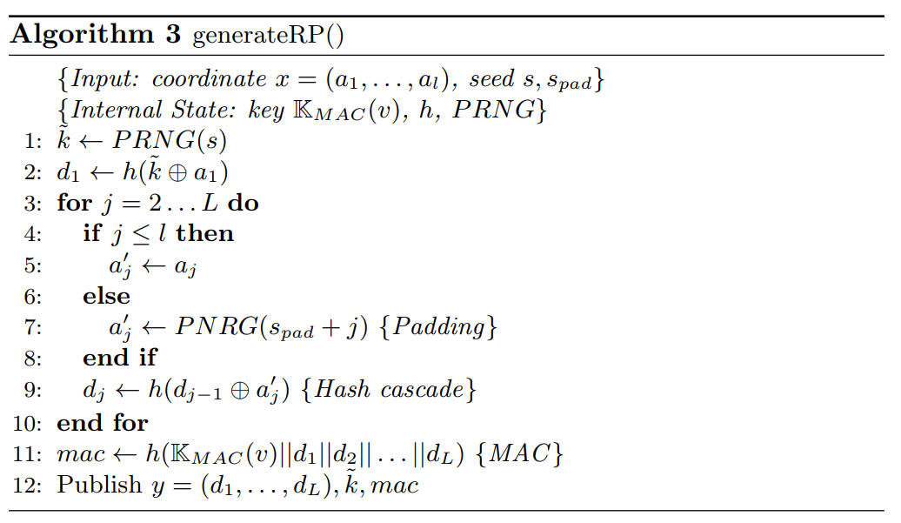
Anonymous Return Addresses

Slide 56
Anonymous Return Addresses - padding
x = (a₁, . . . , a_{n}) is the input coordinate
n = input length, N = after padding length
padded coordinate: x’ = (a’₁, . . . , a’_{n}, a’_{n+1}, . . . , a’_{N})
(a’₁, . . . , a’_{n}) = (a₁, . . . , a_{n}) (a’_{n+1}, . . . , a’_{N}) = PRNG(seed_{pad} + j), n < j <= N

Slide 57
Anonymous Return Addresses - hash cascade
key
hash
d₁
hash
d₂
a’₁
a’₂
a’₃
y = (d₁, . . . , d_{N}) = hc(x, key) return address: (y, key) cpl(x, c) = cpl(y, hc(c, key))

Slide 58
routePay()
The receiver generates anonymous return addresses and sends them to the sender
The sender randomly splits the transaction value on |L| paths, one for each landmark
VOUTE’s routing algorithm finds a path between sender and receiver, restricted to links that have sufficient funds

Slide 60
routePay()
The receiver generates anonymous return addresses and sends them to the sender
The sender randomly splits the transaction value on |L| paths, one for each landmark
VOUTE’s routing algorithm finds a path between sender and receiver, restricted to links that have sufficient funds

Slide 61
VOUTE’s routing algorithm (Embedding-based)
| id | is the coordinate length
cpl is common prefix length

Slide 62
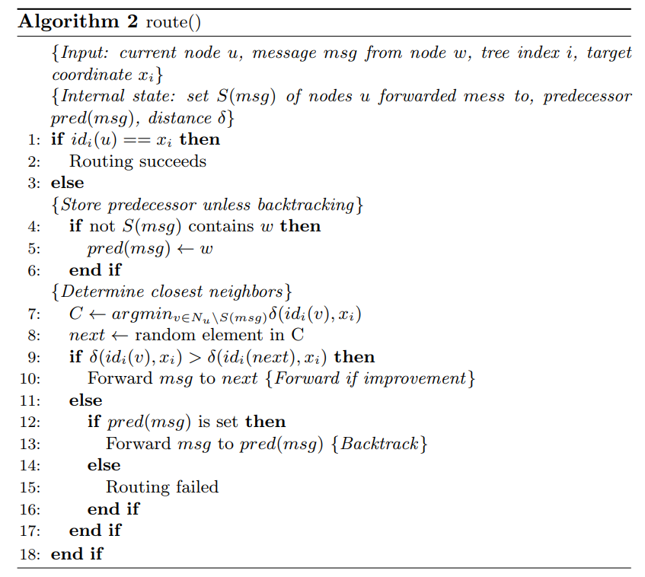

Slide 63
Routing Algorithms - Concurrency
VOUTE: Each node would select the neighbor with the coordinate closest to the destination ------- When they choose a link at the same time, the link might have insufficient available credit!
SpeedyMurmurs: The routing only considers links (v, u) with guaranteed available credit of at least c_{i}
Guaranteed available credit:
lower bound on the available credit if ongoing probe operations succeed.
Initialized to actual available credit.
Decreased c_{i} when transaction to prevent other routing using the link.
Adding c_{i} back if the routing fails.

Slide 65
Routing Algorithms - Parameters
The number of landmarks |L|: The transaction and stabilization overhead increases roughly linearly
The number of transaction attempts a: A sender S can attempt to perform a transaction up to a times
S chooses the interval between two consecutive attempts uniformly at random within an interval of length tl

Slide 66
Routing Algorithms - Privacy Analysis
Value Privacy
Sender/Receiver Privacy

Slide 72
Sender/Receiver Privacy
The adversary cannot determine whether the actual sender is S or another user S’ connected to S through a direct link or a path of non-compromised users.
The adversary cannot fully determine yet if R is the actual receiver, or the routing message is intended for another receiver R’ connected to R through a direct link or a path of non-compromised users

Slide 73
Notes:
Ford–Fulkerson algorithm (FFA) is a greedy algorithm that computes the maximum flow in a flow network. max-flow min-cut

Slide 79
Thank you! Questions?

